Slide 1

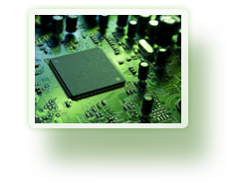


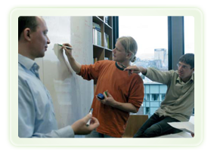




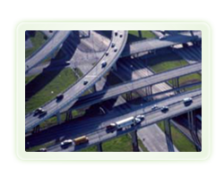



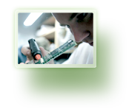


From imagination to impact

Slide 2







Track Assist
Design Notes
David Rawlinson
Notes:
Explain difference in title from advertised one and difference in emphasis

Slide 3
Key Objectives & Constraints
Cross platform compatibility desirable (Windows, Linux, Apple)
Import directly from (most/all) digital microscopes
Graphics-heavy client
Lots of “smart tools”: human-assisted manipulation of data
Ability to retroactively add new algorithms
Managed storage of GBs of imagery
Easy import / export of data from other programs:
  Import 3rd party segmentation
  Export Track Assist segmentation
  Export Track Assist tracking & lineage solutions
  Export computed properties of cell detections and tracks
movie_07_in_toto_microscopy.avi

Slide 4
Technology Choices & Platforms
Relational Database (SQL) for persistence (Postgres)
Graphics-heavy client – can’t (easily) be web based
Centralized storage of imagery (on filesystem not in DB)
Java language
Program config stored in database, except java .properties
Java
Swing
UJMP
ImageJ
Hibernate
JDBC
Filesystem
Database

Slide 5
Project Management
NICTA SVN for code repository and backup.
URL:
svn+ssh://login.nicta.com.au/import/apu/projects/1/MIDAS/svn/CellTracking/
Netbeans 6.9.1 as IDE (comes bundled with Java)
Postgres PGAdmin tool for RDBMS
WinMerge recommended for Diff’ing files.
Tortoise SVN (shell integration)

Slide 6
Software APIs
GUI: Java Swing, Java2D
Containers: Java collections
Image processing: ImageJ
Persistence: Hibernate, Reflections → JDBC
Matrices: UJMP
Java
Swing
UJMP
ImageJ
Hibernate
JDBC
Filesystem
Database
movie_07_in_toto_microscopy.avi

Slide 7
Design Patterns: Singleton
A singleton is a class that has exactly one instance. No other instances are possible.
This pattern makes it possible to share the single instance without having to pass around references, because you can access the instance via a static method.
movie_07_in_toto_microscopy.avi

Slide 8
Design Patterns: Object Directory
An Object Directory (OD) allows dynamic definition of singleton objects by storing them in a container (the directory) using a String key. The OD allows classes to self-assemble necessary references by finding them in the OD. This reduces the clutter of member functions for maintenance of reference members.
Only significant single-point components of the program should be stored in the OD. Less important references should be assembled as normal.
Every object in the OD must have a unique String key.
movie_07_in_toto_microscopy.avi

Slide 9
Design Patterns: Observer
An Observer is an object A that registers its interest in another object B. B then notifies A when B is changed.
This pattern is typical of how dependencies are resolved, but is also a simpler form of the Model-View-Controller pattern (next).
movie_07_in_toto_microscopy.avi

Slide 10
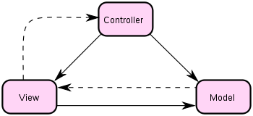
Design Patterns: Model-View-Controller
Model-View-Controller (MVC) is a pattern designed to separate the various roles involved in maintaining internal state (model), displaying the state to the user (view), and responding to user command to manipulate the state (controller). There are disagreements about the details of the separation of roles, but in general:
Direct reference
Indirect relationship
movie_07_in_toto_microscopy.avi

Slide 11
Some Coding Standards
Java conventions apply throughout, no C-style braces.
Prefix classnames with Ct for Cell Tracking, to prevent name collisions with other libraries
Programmatically-generated or constrained non-user Strings should be forced to lowercase and hyphenated, no spaces, colons, commas or other punctuation.
Key names derived from class names should follow this pattern e.g. MyClass → my-class
Don’t abbreviate, make method names systematic
Use get/set methods where appropriate or where members should be protected
movie_07_in_toto_microscopy.avi

Slide 12
Checkin Procedure
Check everything works. Follow the basic functionality system test. Make a backup of your code
Update to head from SVN.
Clean, rebuild all.
Perform system test again, to check things still work. Ad-hoc test the parts you’ve edited.
Visually inspect every difference using a diff tool (e.g. WinMerge, Meld)
Resolve any conflicts, changes required.
Clean, rebuild all.
If any edits, perform system test again, to check things still work. Ad-hoc test the parts you’ve edited.
If OK, commit changes.
Checkout fresh copy.
Perform system test again, to check things still work. Ad-hoc test the parts you’ve edited. This test will check for e.g. files you forgot to add to repo.
movie_07_in_toto_microscopy.avi

Slide 13
Key Concepts
Experiment
A set of related images from the same physical experiment.
Detection
The observation of a cell in a specific image.
Track
A sequence of detections representing the same object.
Lineage
The ancestry of detections and tracks, the relations of tracks.
Solution
All the meta-data (tracks, detections, lineage) of an experiment
Coordinate
An N-d position defining an image within the set of images
ImageSequence
Ordered series of related images e.g. a sequence in time
Microwells
Physical divisions in the experiment that separate cells.
Annotation
Meta-information about something in the imagery.
movie_07_in_toto_microscopy.avi

Slide 14
Key Entities (Classes)
CtFrame
The outermost Swing container for the application.
CtZoomCanvas
A super-resolution pan-zoom image display component.
CtTool
A tool that is sometimes enabled and has Swing controls.
CtImageOperation
An object that can produce a specific image result.
CtImageResult
A wrapper for an ImageJ image, for efficient pixel-data-access
CtAbstractFactory
An object that can create instances of a specific derivable type
CtObjectDirectory
A container for named objects
CtChangeModel
Base type for MVC models, notifies Observers of changes
CtPageController
Controls the sequence and selection of screens shown to user based on the options they select...
movie_07_in_toto_microscopy.avi

Slide 15
Key Entities (Classes)
The logical structures built on top of the imagery are implemented as a hierarchy of
MVC Controllers. In this diagram, arrows point from Listeners towards objects they
observe.
CtExperimentController
CtSolutionController
CtCoordinatesController
CtTrackingController
CtImageSequenceController
CtLineageController

